Slide 1
Сентябрь
1 | 2 | 3 | 4 | 5 | 6 | 7
8 | 9 | 10 | 11 | 12 | 13 | 14
15 | 16 | 17 | 18 | 19 | 20 | 21
22 | 23 | 24 | 25 | 26 | 27 | 28
29 | 30

Slide 2
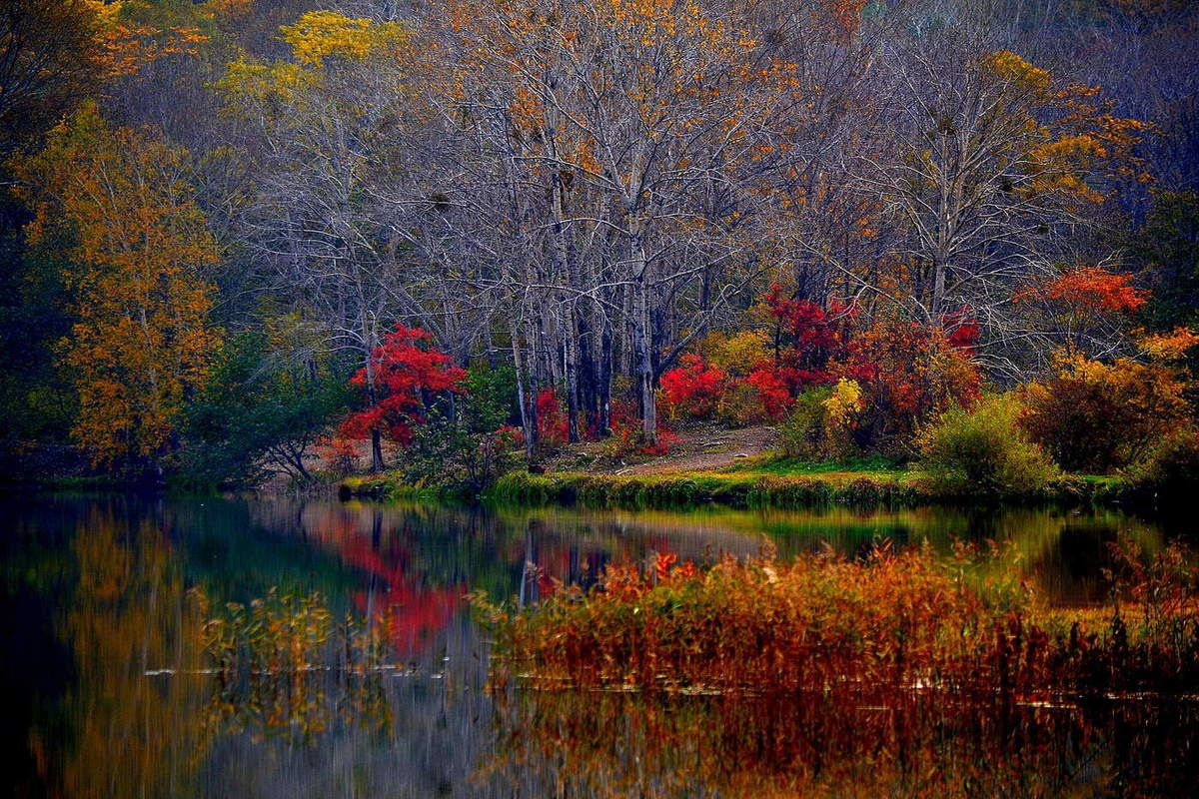
Октябрь
1 | 2 | 3 | 4 | 5 | 6 | 7
8 | 9 | 10 | 11 | 12 | 13 | 14
15 | 16 | 17 | 18 | 19 | 20 | 21
22 | 23 | 24 | 25 | 26 | 27 | 28
29 | 30 | 31

Slide 3
Ноябрь
1 | 2 | 3 | 4 | 5 | 6 | 7
8 | 9 | 10 | 11 | 12 | 13 | 14
15 | 16 | 17 | 18 | 19 | 20 | 21
22 | 23 | 24 | 25 | 26 | 27 | 28
29 | 30

Slide 4
Декабрь
1 | 2 | 3 | 4 | 5 | 6 | 7
8 | 9 | 10 | 11 | 12 | 13 | 14
15 | 16 | 17 | 18 | 19 | 20 | 21
22 | 23 | 24 | 25 | 26 | 27 | 28
29 | 30 | 31

Slide 5
Январь
1 | 2 | 3 | 4 | 5 | 6 | 7
8 | 9 | 10 | 11 | 12 | 13 | 14
15 | 16 | 17 | 18 | 19 | 20 | 21
22 | 23 | 24 | 25 | 26 | 27 | 28
29 | 30 | 31

Slide 6
Февраль
1 | 2 | 3 | 4 | 5 | 6 | 7
8 | 9 | 10 | 11 | 12 | 13 | 14
15 | 16 | 17 | 18 | 19 | 20 | 21
22 | 23 | 24 | 25 | 26 | 27 | 28

Slide 7
Март
1 | 2 | 3 | 4 | 5 | 6 | 7
8 | 9 | 10 | 11 | 12 | 13 | 14
15 | 16 | 17 | 18 | 19 | 20 | 21
22 | 23 | 24 | 25 | 26 | 27 | 28
29 | 30 | 31

Slide 8
Апрель
1 | 2 | 3 | 4 | 5 | 6 | 7
8 | 9 | 10 | 11 | 12 | 13 | 14
15 | 16 | 17 | 18 | 19 | 20 | 21
22 | 23 | 24 | 25 | 26 | 27 | 28
29 | 30

Slide 9
Май
1 | 2 | 3 | 4 | 5 | 6 | 7
8 | 9 | 10 | 11 | 12 | 13 | 14
15 | 16 | 17 | 18 | 19 | 20 | 21
22 | 23 | 24 | 25 | 26 | 27 | 28
29 | 30 | 31

Slide 10
Июнь
1 | 2 | 3 | 4 | 5 | 6 | 7
8 | 9 | 10 | 11 | 12 | 13 | 14
15 | 16 | 17 | 18 | 19 | 20 | 21
22 | 23 | 24 | 25 | 26 | 27 | 28
29 | 30

Slide 11
Июль
1 | 2 | 3 | 4 | 5 | 6 | 7
8 | 9 | 10 | 11 | 12 | 13 | 14
15 | 16 | 17 | 18 | 19 | 20 | 21
22 | 23 | 24 | 25 | 26 | 27 | 28
29 | 30 | 31

Slide 12
Август
1 | 2 | 3 | 4 | 5 | 6 | 7
8 | 9 | 10 | 11 | 12 | 13 | 14
15 | 16 | 17 | 18 | 19 | 20 | 21
22 | 23 | 24 | 25 | 26 | 27 | 28
29 | 30 | 31

