Slide 1
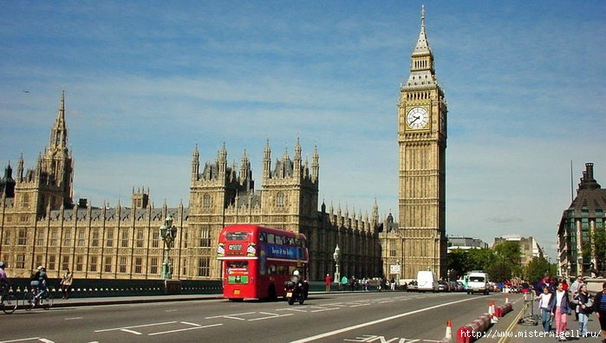
Welcome to Great Britain

Slide 2
Elizabeth II

Slide 3
Buckingham palace

Slide 4
ROYAL FAMILY

Slide 5
It is foggy

Slide 6
It is rainy

Slide 7
Big Ben

Slide 9
London Zoo

Slide 10
It’s a lion

Slide 11
It’s a bear

Slide 12
It’s a panda

Slide 13
It’s a tiger

Slide 14
These are giraffes

Slide 15
These are penguins

Slide 16
These are flamingo

Slide 17
These are zebras

Slide 18
It’s a monkey

Slide 19
It’s a crocodile

Slide 22
GOOD BYE
SEE YOU

